Slide 1
Chrome River Updates
Fig Meeting
February 25, 2020

Slide 2
Pre-Approval Updates
Required Location Field The location is required on all Instate, Out of State and International Travel Pre-Approval Reports. Not in the menu – Allows you to type it in
Boss’s Supervisor Approval If a Pre-Approval is entered after the date of the travel begins, it now requires the additional approval.
Advance Payments Advance Payments are distributed no earlier than 2 weeks prior to travel.
Pre-Approvals are no longer approved by Accounts Payable except for those with a Travel Advance included.

Slide 3
Expense Form Updates
Misc. Tile
Supplies
Change Fee Justifications
Report Type | Travel Exp | Non Travel
Misc | Misc Exp | Misc Tile included w Itemization
Supplies | CC1 corrected | Available
Chg Fee | Ticket & Seat

Slide 4
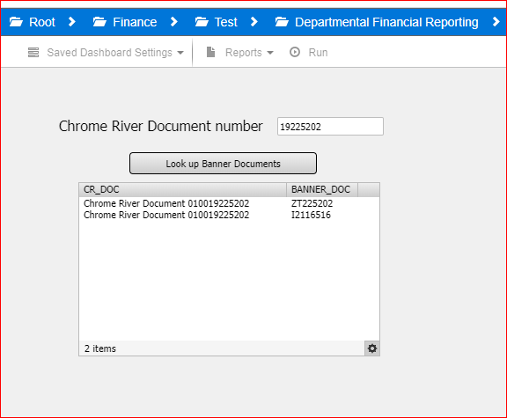
ZT Numbers are now Z1
New Argos Look-Up tool.
Enter the last 8 numbers of the Chrome River Report Number.
Receive all the Banner Doc relating to the report

Slide 5
Purchasing Cards older than 90 Days How To Handle Them ?
Problems:
Unable to move to the personal AR w/o a Report in Chrome River.
Current Balance not exported to Banner 1.5 m dollars.
Not on index’s, possible grant closing – no funding, wrong fiscal year – person left the UI.
Options:
1. Inactivate Purchasing Cards for Individual until reports are up to date.
2. Remove pcards from the cardholder.
3. Remove pcards from the division or college.
Reimbursement only!!

