Slide 1
Resilience of Water Resources – Idaho’s Programs and Measures

Slide 2
Sovereignty Over Idaho Water
Idaho Constitution
Article XV Section 1 – All use of water subject to state control and regulation
Article XV Section 7 – Established the Water Bond
Case Law
  Ickes v. Fox, 300 US 82 (1937) – Congress severed land and water on public domain by the Desert Land Entry Act – if not before
  California v. U.S., 438 US 645 (1975) – Recognized Congress’ deference to state law
  Joyce Livestock Co. v. U.S., 144 Idaho 1 (2007) – Appropriation a matter of state law

Slide 3
Water Board
1988 Amendments to Water Resource Board Statutes
  Section 1. The legislature finds and declares that a central component of state sovereignty is the inherent right of the state to regulate and to control the natural resources of this state. In a state such as Idaho, it is essential that the state exercise its full authority to manage its water. To that end, it is the purpose of this act to provide for the full exercise of all the state’s rights and responsibilities to manage its water resources.
  Idaho Session Laws, 1988, Chapter 370
2012 State Water Plan (current)
  1A – State Sovereignty
  The State asserts sovereignty over the development and use of Idaho’s water resources for the benefits of its citizens. Any action by the federal government or other states that would impair Idaho’s sovereignty over its water resources is against state policy.

Slide 4
Nez Perce Reserved Water Right Claims
Raised in the Snake River Basin Adjudication
Settled in 2004
  Mediators Term Sheet (srba.state.id.us/NezPerceHTM)
  Snake River Water Rights Act of 1804 PL No. 108-447
  E. This agreement, the decree, and the order approving this agreement may not be modified in any manner except as herein provided or with the joint written consent of the duly authorized representatives of the parties and the consent of the court approving this agreement, which court shall have the sole jurisdiction to modify its decree.
42-1763B
  Flow augmentation – Interim Authority for Water Rental

Slide 5
U.S. v. Pioneer Irrigation District, 144 Idaho 106 (2007)
The name of the United States appears on the water right decree
Title to the use of the water is held by the water users and the irrigation organizations act on behalf of the users to administer the water

Slide 6
Pending Sovereignty Dispute – Stockwater Rights
U.S. v. State of Idaho, et al., Case No. 1:22-cv-00236DCN (Dist. Idaho)
Joyce Livestock v. U.S., 144 Idaho 1 (2007)
  Ranchers can get a stock water right on public land
  Must put water to beneficial use by watering livestock
Forfeiture Proceedings mitigation; U.S. Sued State
  Idaho Code 42-224 - Forfeiture of stock water rights
  Idaho Code 42-502 - Federal government can’t own stockwater rights
  Idaho Code 42-113(2)(b) - Base property
  Idaho Code 42-504 – Place of use

Slide 7
U.S. Claims
  Exempt from forfeiture – no McCarren Amendment Waiver
  Administration 43 USC Section 666
    Doesn’t include forfeiture
    Discriminatory against the U.S.

Slide 8
Idaho’s Water Resources Over Time
A. Boise
B. Upper Snake
C. Salmon

Slide 9
A. Boise

Slide 10
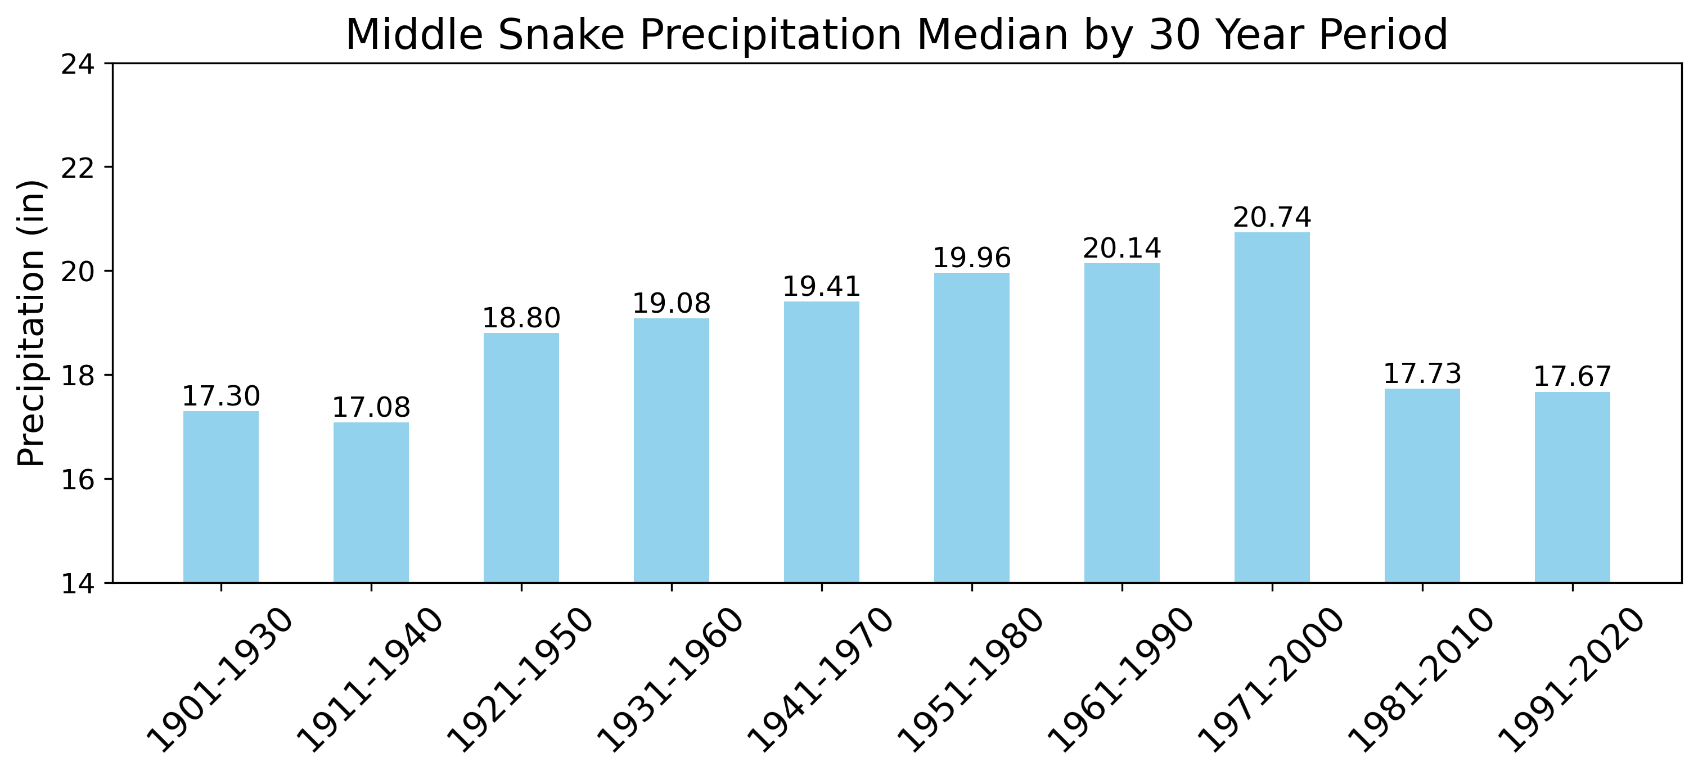

Slide 11
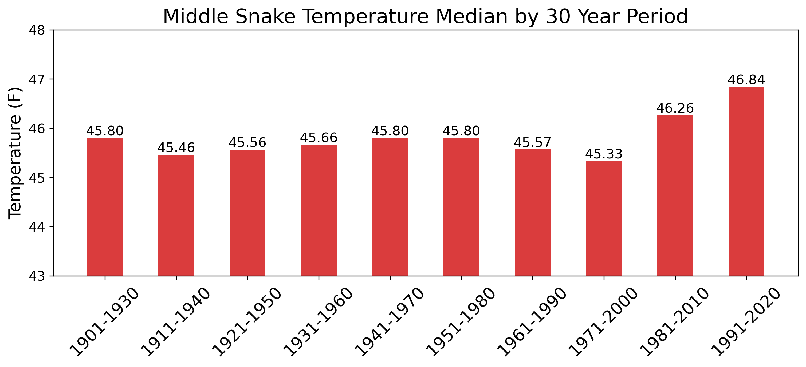

Slide 12
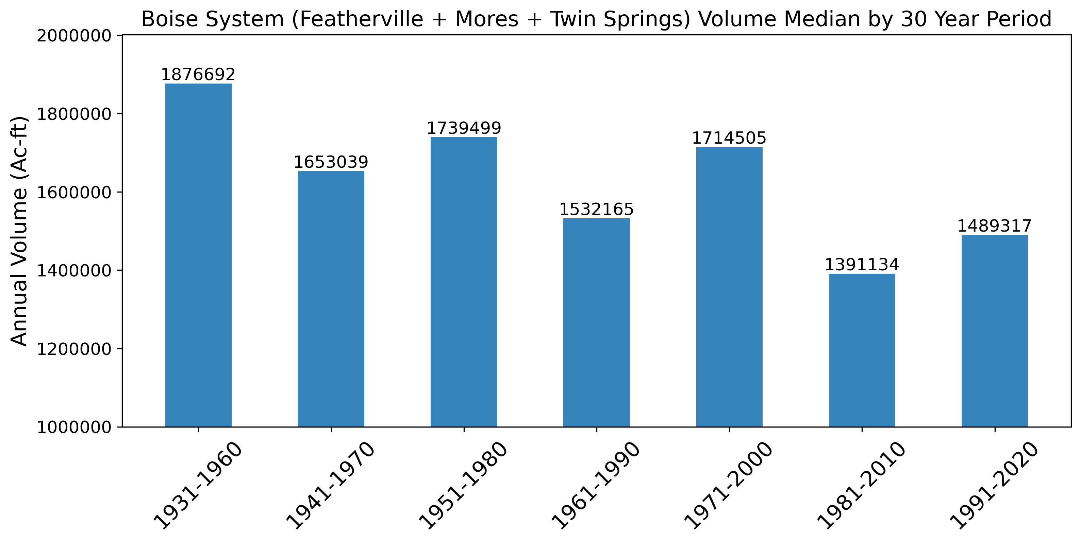

Slide 13
B. Upper Snake

Slide 14
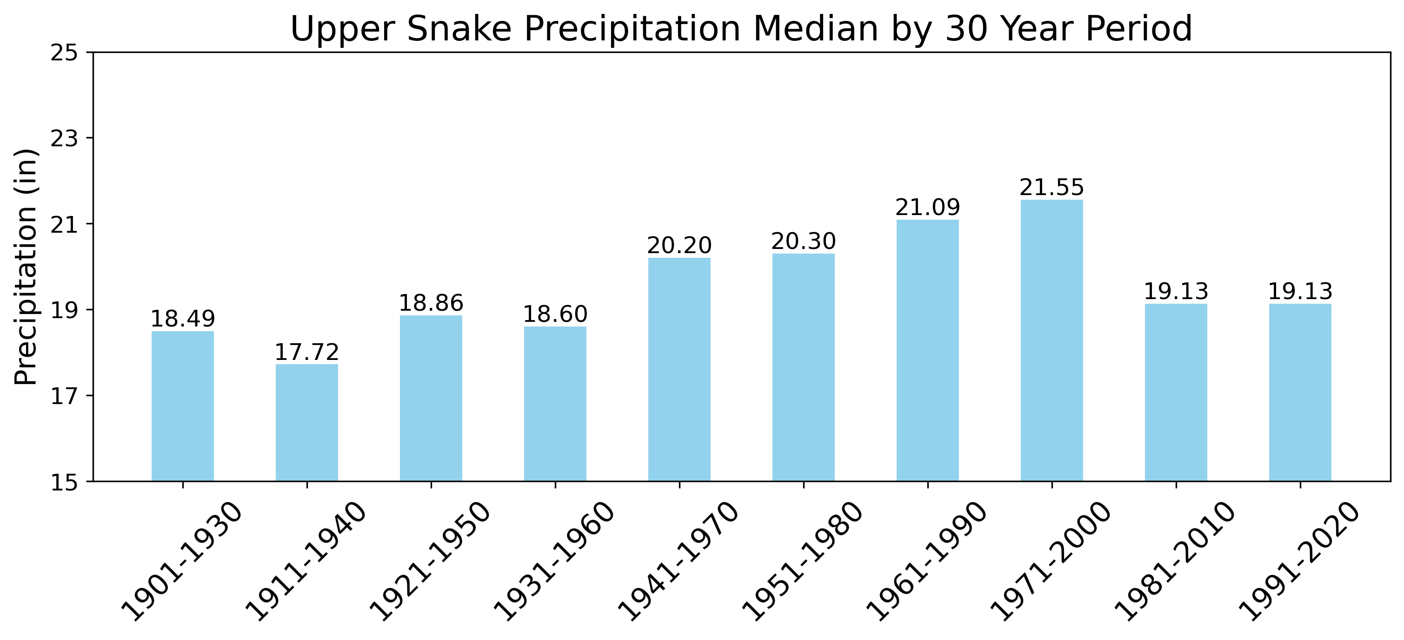

Slide 15
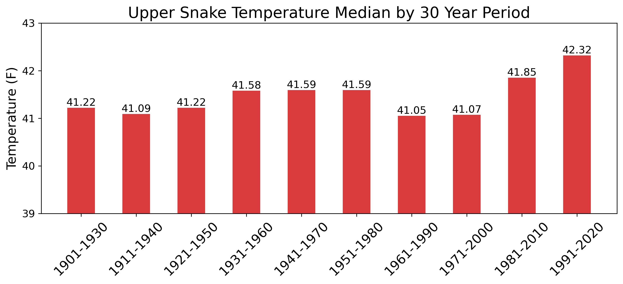

Slide 16
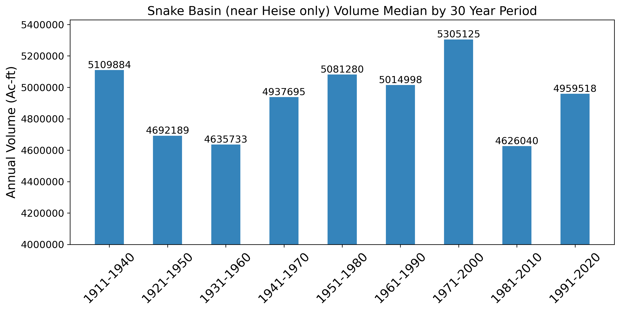

Slide 17
C. Salmon

Slide 18
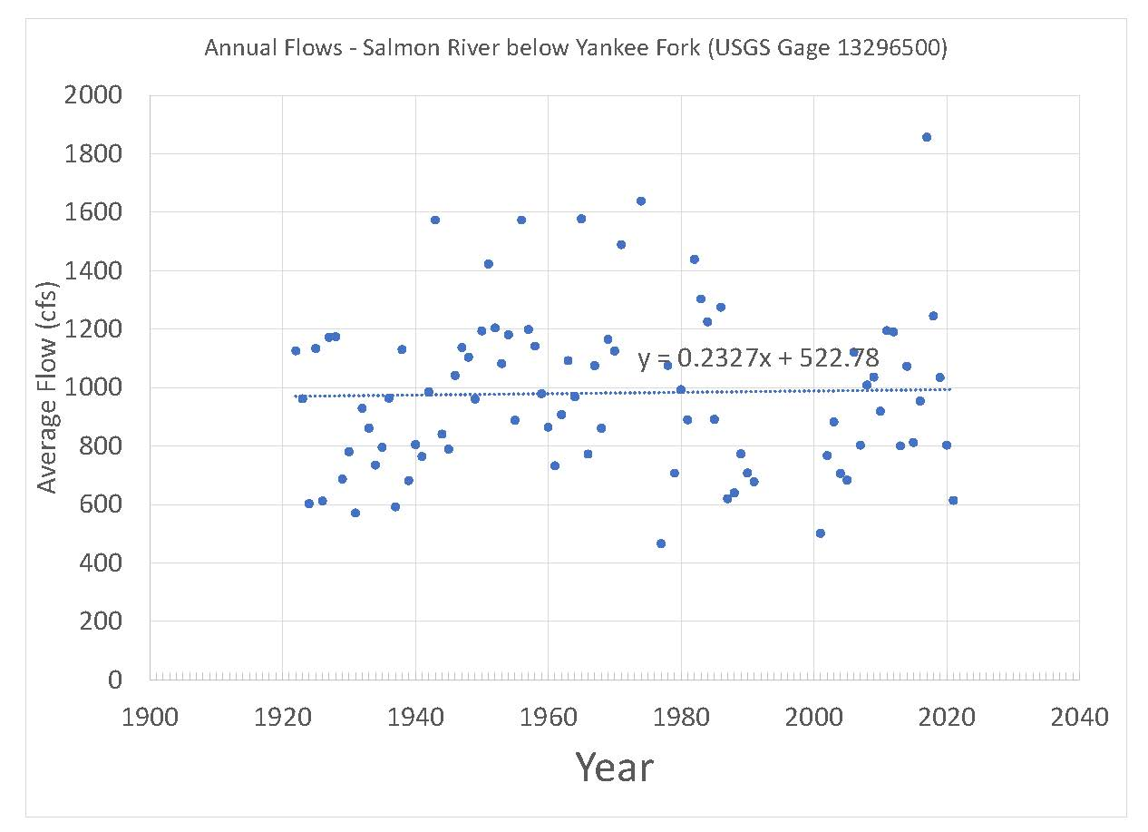

Slide 19
Idaho Water Resource Board Programs
A. Recharge
B. Cloud Seeding
C. Infrastructure – Grants and Loans
D. Minimum Stream Flows
E. Water Transaction Program

Slide 20
A. Recharge
1. Groundwater recharge is a beneficial use
  Idaho Code 42-234(b) (added 1978)
  City of Blackfoot v. Spackman, 162 Idaho 397 (2017)
2. Recognized in State Water Plan
  Policy 1.I.
3. Water Board Recharge Rights
4. Federal Impediments
  BLM protests to applications 37-23110 and 37-23111
  Aquifer Recharge Flexibility Act, Section 1105 of PL 116-260
  BLM claims that Water Board cannot use the Act
    T. Stone-Manning to Idaho Congressional Delegation Feb. 20, 2024

Slide 21
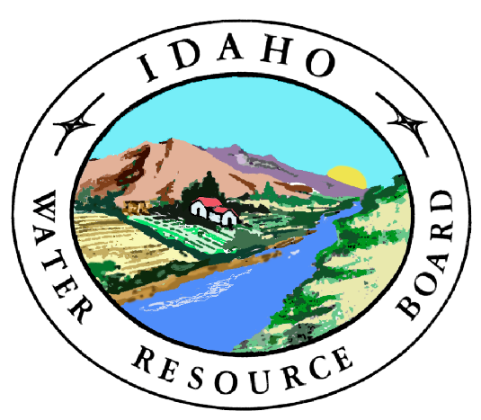
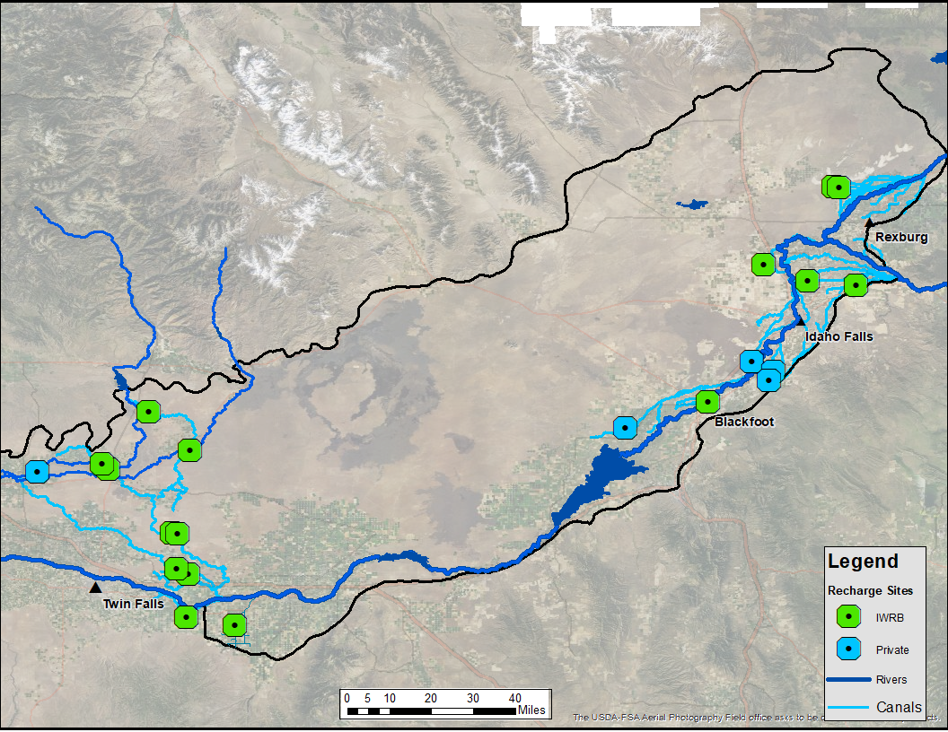
Lower Valley Recharge Capacity
Canals - 700 cfs
Sites - 2,000 cfs
Upper Valley Recharge Capacity
Canals - 1,500 cfs
Sites - 450 cfs
Existing Recharge Capacity
IWRB Agreements Upper Valley Capacity
Sites - 150 cfs
Canals - 600 cfs

Slide 22
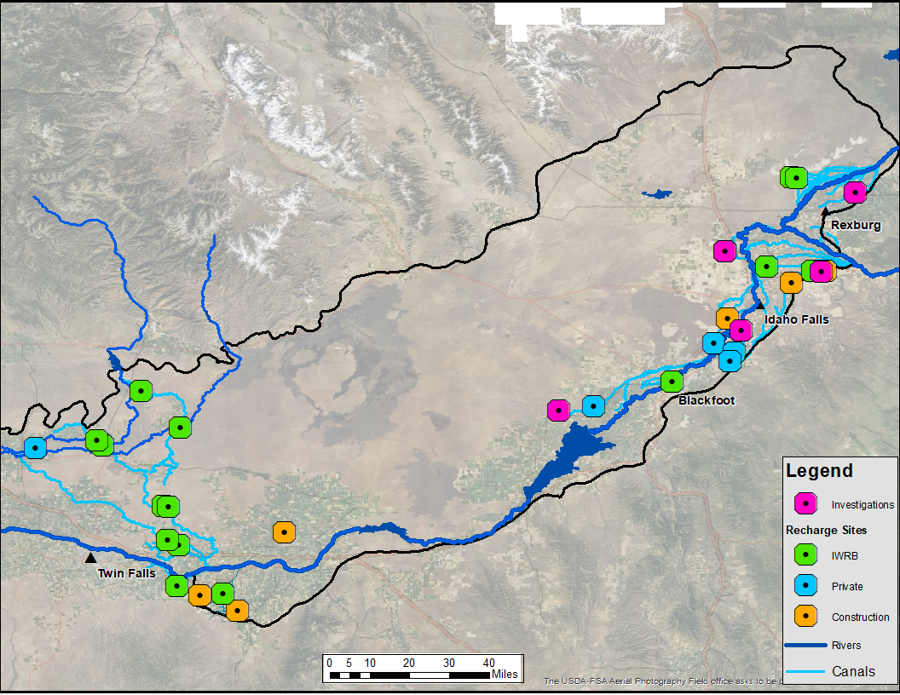
Increased Upper Valley Recharge Capacity
Canals - 1,500 cfs
Sites - 585 cfs
Increased Lower Valley Recharge Capacity
Canals - 700 cfs
Sites - 2,110 cfs
Potential New Recharge Capacity
New Site Capacity – Planned Construction
Lower Valley sites - 110 cfs
Upper Valley sites - 135 cfs
New Site Capacity Under Investigation
All sites - 350 cfs

Slide 23
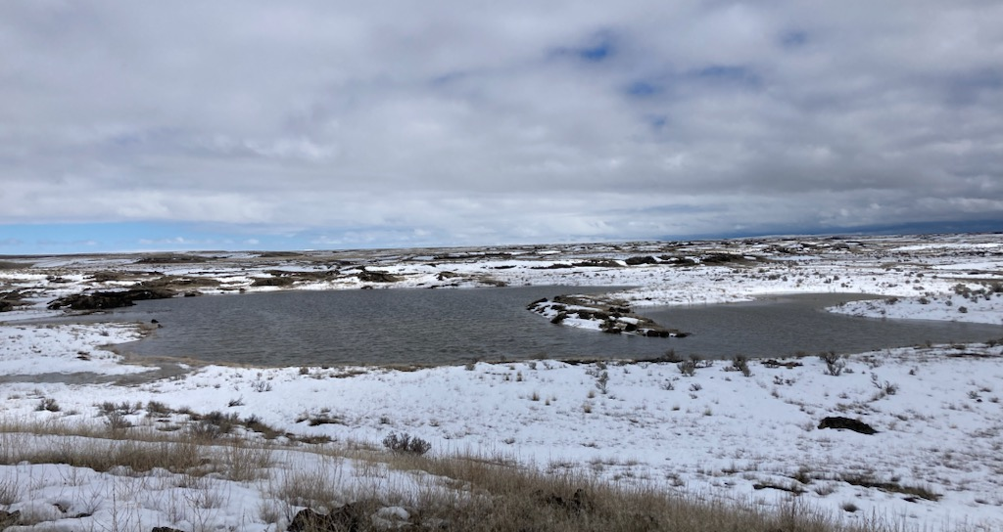
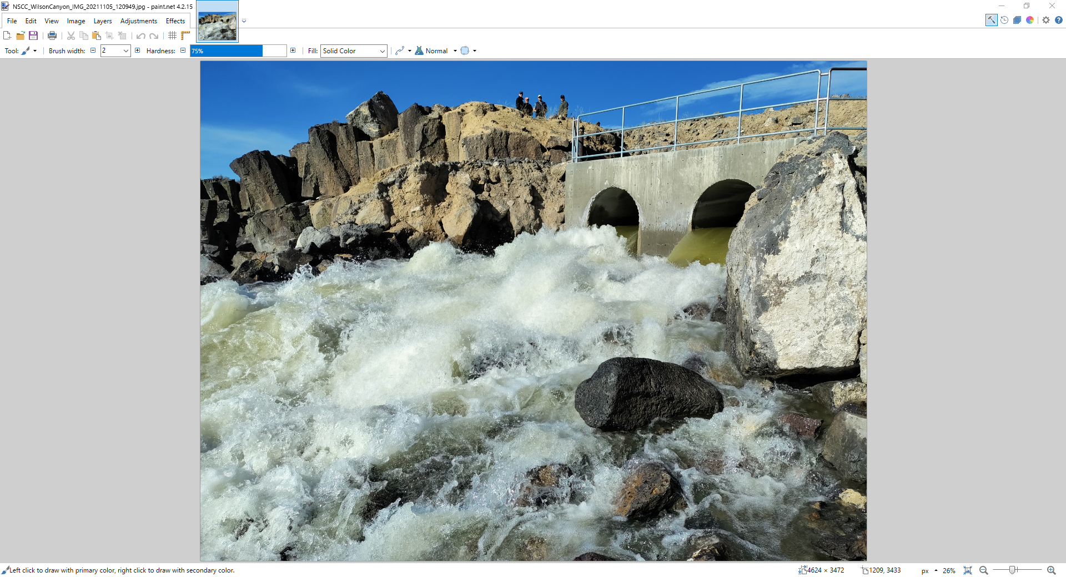
ESPA Recharge Annual Volume
Year | Natural Flow Volume (Acre-Feet) | Storage Volume (Acre-Feet)
2014-2015 | 75,475
2015-2016 | 66,897
2016-2017 | 317,714
2017-2018 | 474,901 | 59,538
2018-2019 | 310,132 | 53,771
2019-2020 | 450,323 | 68,308
2020-2021 | 130,463 | 63,393
2021-2022 | 157,586 | 0
2022-2023 | 146,943 | 0
AVERAGE | 236,715

Slide 24
2023

Slide 25
B. Cloud Seeding
Idaho Code 42-4301
  State Policy to Support Cloud Seeding
  Water Board Sponsor
  Where Cloud Seeding May Occur
  Payette, Boise, Big Wood, Upper Snake Basins
  Evaluating Bear and Lemhi Basins

Slide 26
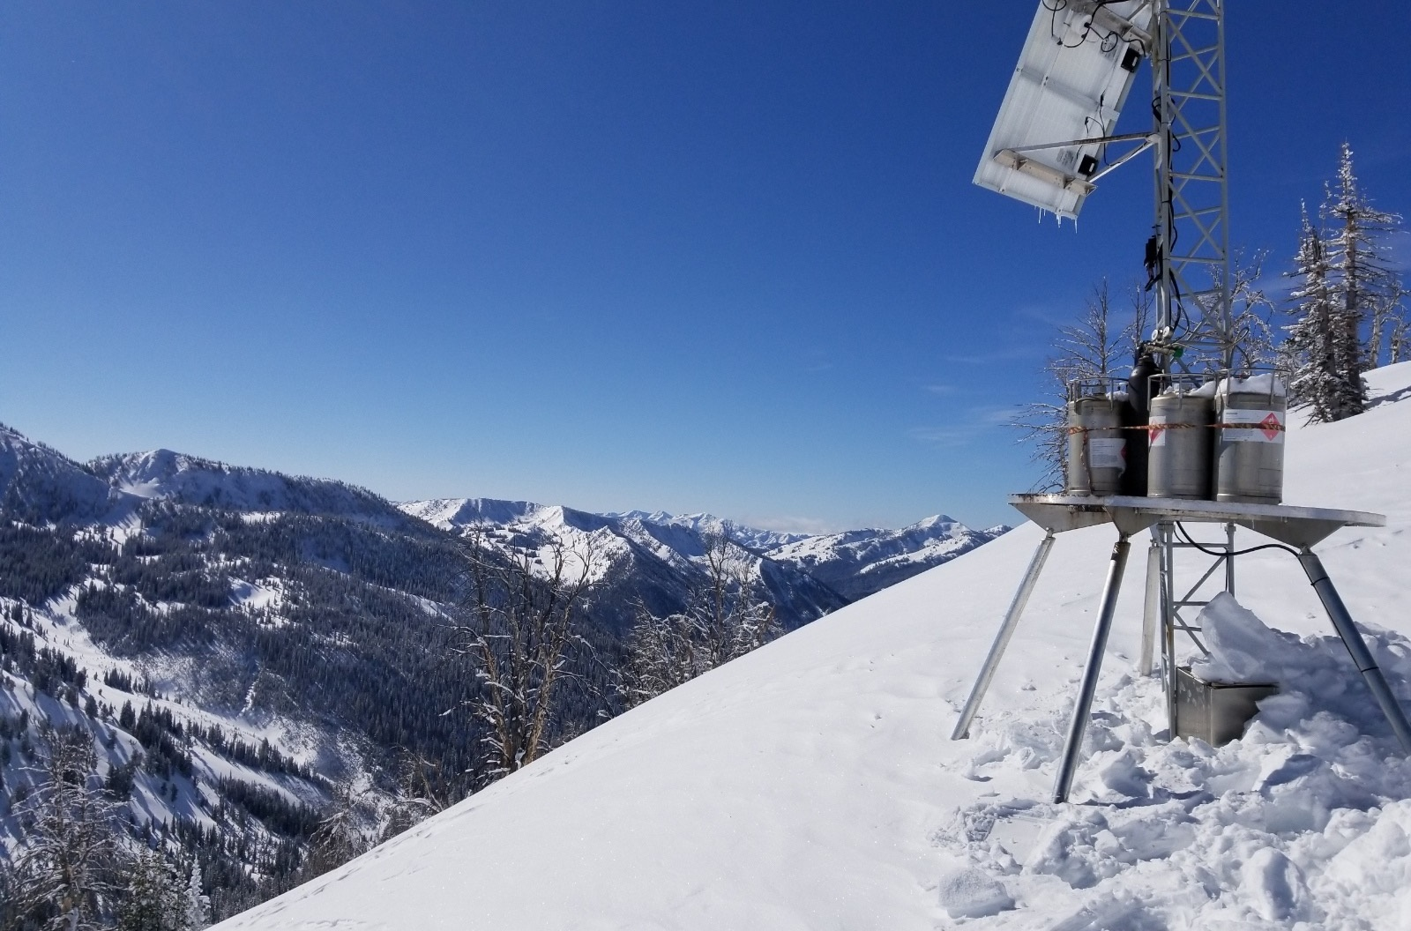
IWRB Cloud Seeding Program
Collaborative Program
Operated in the Upper Snake, Boise, Wood River basins
Partnership between IWRB, Idaho Power Company (IPC), and local water users in basins of operation
IPC performs cloud seeding operations, and the State and local water users participate in program funding
IPC operates an independent project in the Payette River Basin in coordination with the collaborative program.
Collaborative Program grew out of ESPA CAMP; IWRB began funding infrastructure buildout in 2014

Slide 27
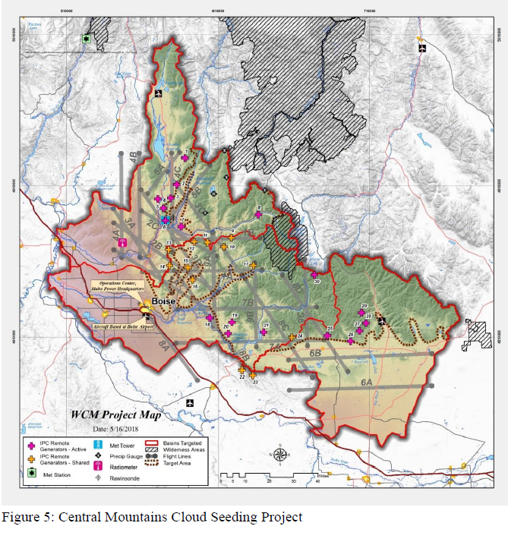
West Central Mountains Projects
Estimated Average Additional Runoff (unregulated) &
Current Project Costs (Annually)
Boise River Basin– 273 KAF | $910K
Wood River Basin – 112 KAF | $670K
Payette River Basin* – 223 KAF | $870K
WCM Total: 608KAF |$2.45M
*Independent project operated by Idaho Power Company in coordination with the Collaborative. 100% Funded by IPC.

Slide 28
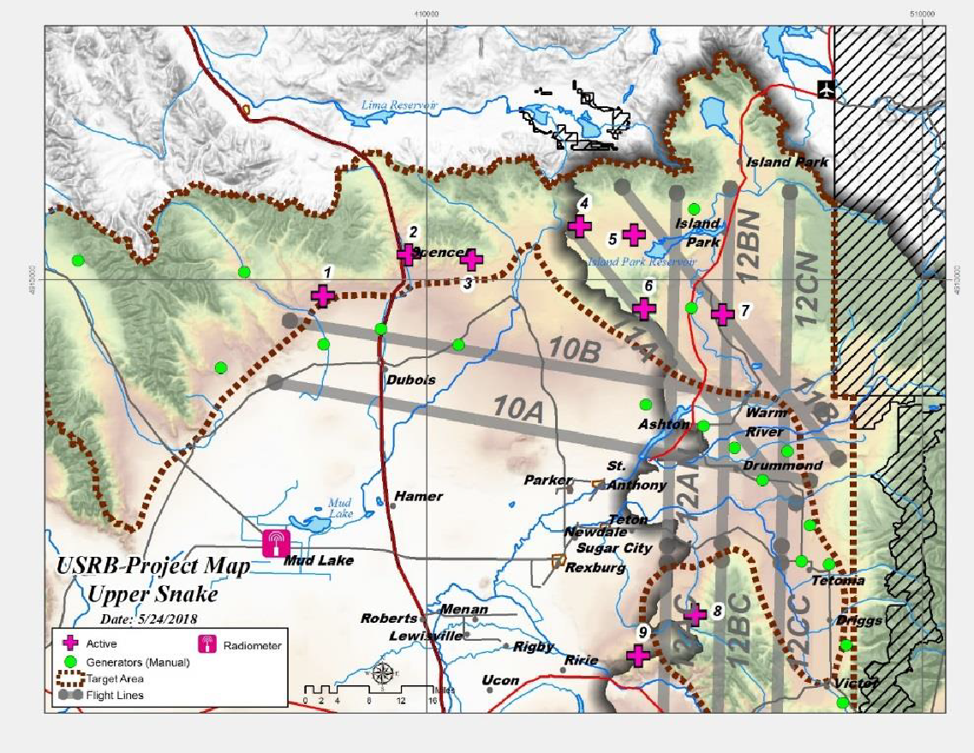
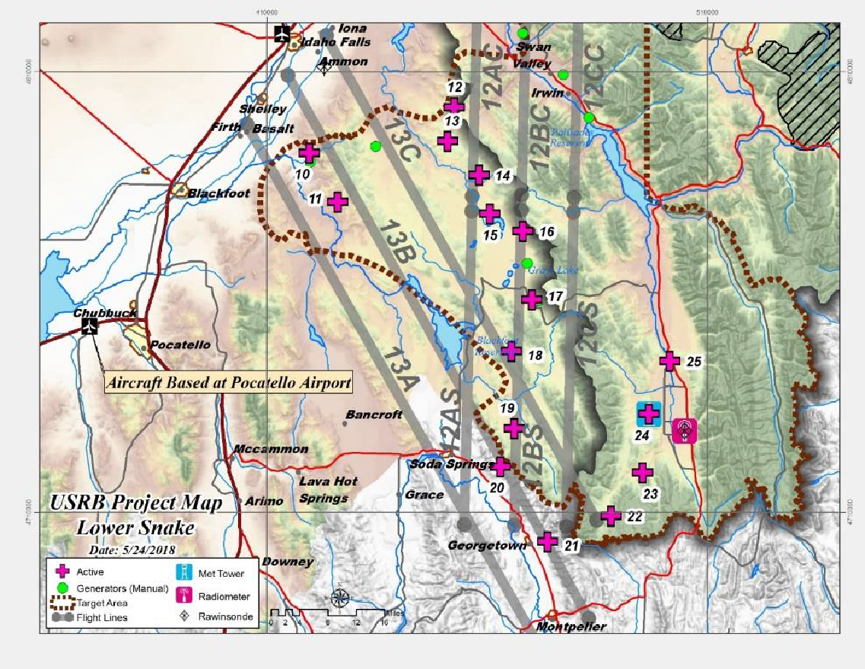
Upper Snake River Basin Projects
Northern Upper Snake | 168 KAF Avg Annual
Southern Upper Snake | 464 KAF Avg Annual
Upper Snake River Basin | 632 KAF | $1.54M

Slide 29
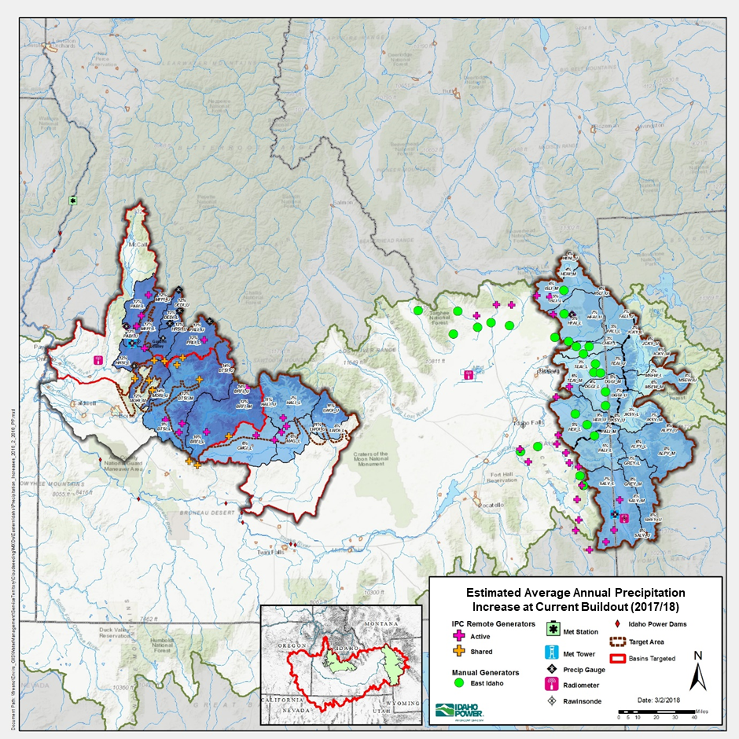
Idaho Collaborative Cloud Seeding Program
57 Remote Ground Generators
3 Aircraft
Network of Weather Instrumentation
Sophisticated Modeling technologies
Atmospheric Science Team
Current Annual Operations Cost: $3,995,000
Average Annual Runoff Generated: 1,240,000 AF
Estimated Cost Per Acre Foot: $3.22/AF
Notes:
ADD NOTES

Slide 30
C. Infrastructure
Water Board Grant and Loan Program

Slide 31
IWRB Financial Assistance Programs
Water Project Loans
Purpose– Assist with the development of the state’s water resources
  Construction of water projects
  Rehabilitation of existing water projects
  Groundwater conservation projects and studies
Funding Period
  Applications accepted year-round
Interest Rate
  Current Federal Prime rate, updated quarterly
Terms Available
  From 5 to 30 years
Securities
  Water rights, property, etc.
  Must meet Idaho Code 42-1756(5)
More information: https://idwr.idaho.gov/IWRB/programs/financial/
Or send inquiry to iwrbloans@idwr.idaho.gov
Flood Management Grants
  Purpose – Preventing or reducing flood damage to Idaho’s streams and rivers.
  Applications due in June
  Funding awarded annually in July
  ½ Cost Share up to $200,000
Aging Infrastructure Grants
  Purpose – Rehabilitate or improve Idaho’s water infrastructure and ensure long-term water resource stability and sustainability.
  ⅓ Cost Share up to $2,000,000
  Applications Due December & August
  Funding Awarded Bi-Annually
Regional Sustainability Program
  Purpose – Provide funding for projects that provide benefits on a region, basin, or state-wide scale
  Funding is a cost share done on a project-by-project basis
  Applications Due December
  Funds Awarded August
More information: https://idwr.idaho.gov/IWRB/programs/financial/
Or send inquiry to iwrbgrants@idwr.idaho.gov

Slide 32
IWRB Financial Assistance Program Activity
  Aging Infrastructure Grants
  Loans
Date | No. Apps Received | No. Apps Approved | Funding Requested | Funding Awarded
Round 1 – Aug 2022 | 31 | 12 | $41,746,786 | $12,500,000
Round 2 – Dec 2023 | 36 | 16 | $28,086,632 | $12,500,000
Round 3 – Aug 2023 | 23 | TBD | $11,302,689 | TBD
Totals | 90 | 28 | $81,136,107 | $25,000,000
Date | No. Apps Received | Amount of Loan Approved
2022 | 12 | $19,614,720
2023 | 8 | $20,114,500
Totals | 20 | $40,429,220
  Flood Grants
Date | No. Apps Received | No. Apps Approved | Funding Requested | Funding Awarded
2022 | 12 | 10 | $1,075,935 | $980,935
2023 | 14 | 10 | $1,323,958 | $1,069,988
Totals | 26 | 20 | $2,399,893 | $2,050,923
More information and interactive maps:
IWRB Financial Programs | Idaho Department of Water Resources

Slide 33
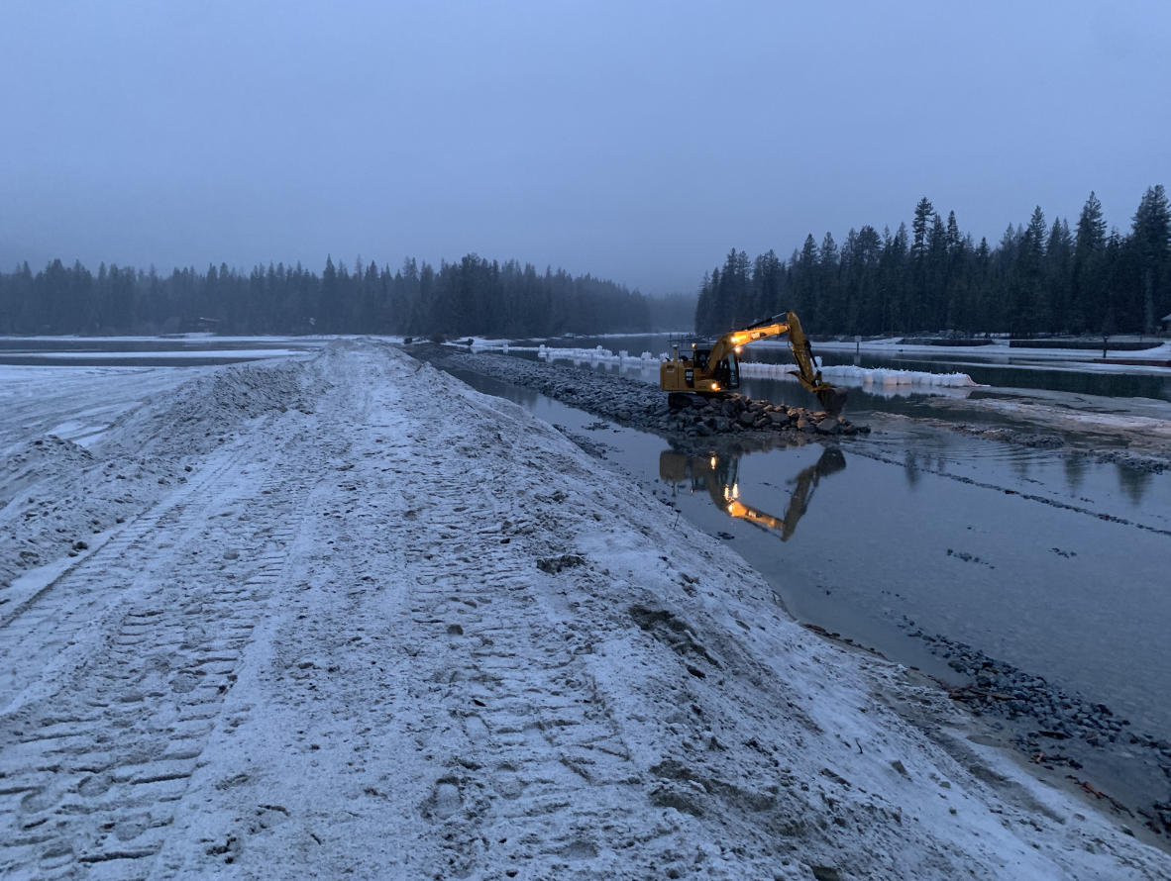
IWRB Regional Water Sustainability State-Led Projects
  ESPA Aquifer Recharge
  Cooperative Cloud Seeding (with Idaho Power & water users)
  MHAFB Sustainable Water Project (with US Air Force)
  Anderson Ranch Dam Raise (with US Bureau of Reclamation)
  Priest Lake –Thorofare and Outlet Dam
  Lemhi Basin Settlement
  Bear Lake
  Other Priority List projects not yet funded
Thorofare/Breakwater Construction at Priest Lake

Slide 34
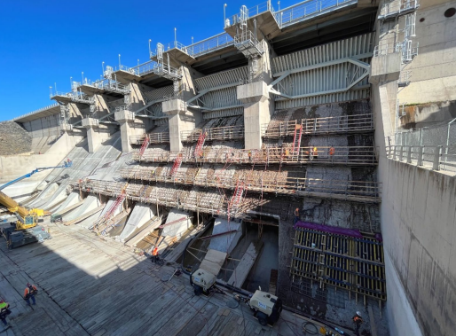
IWRB Regional Water Sustainability State – Led by Others
  Gooding – Little Wood River Channel
  Nampa Wastewater-to-Irrigation Reuse
  Raft River Pipeline
  Palouse Basin Aquifer Supply Planning
  Lost Valley Reservoir Expansion Planning
  North Fremont Canals
  American Falls Spillway
  New York Canal Rehabilitation
  Ririe Reservoir Rule Curves Analysis
  Other Priority List projects not yet funded
American Falls Dam Spillway Repair

Slide 35
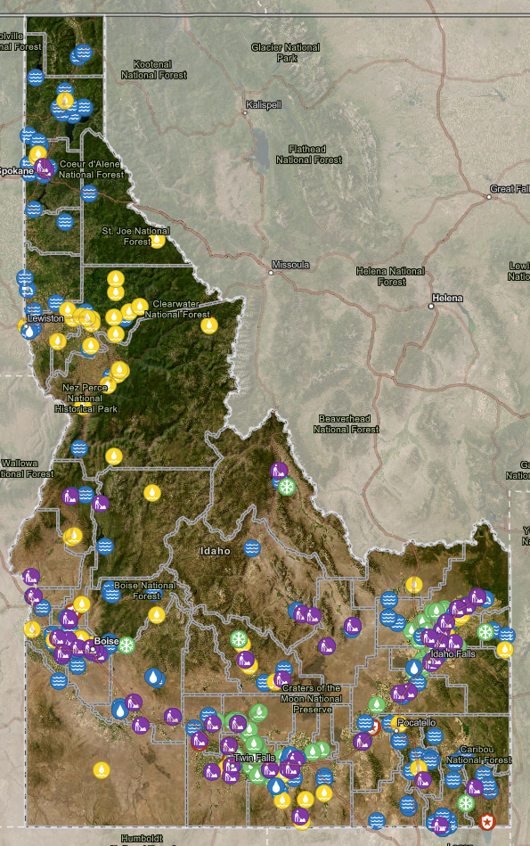
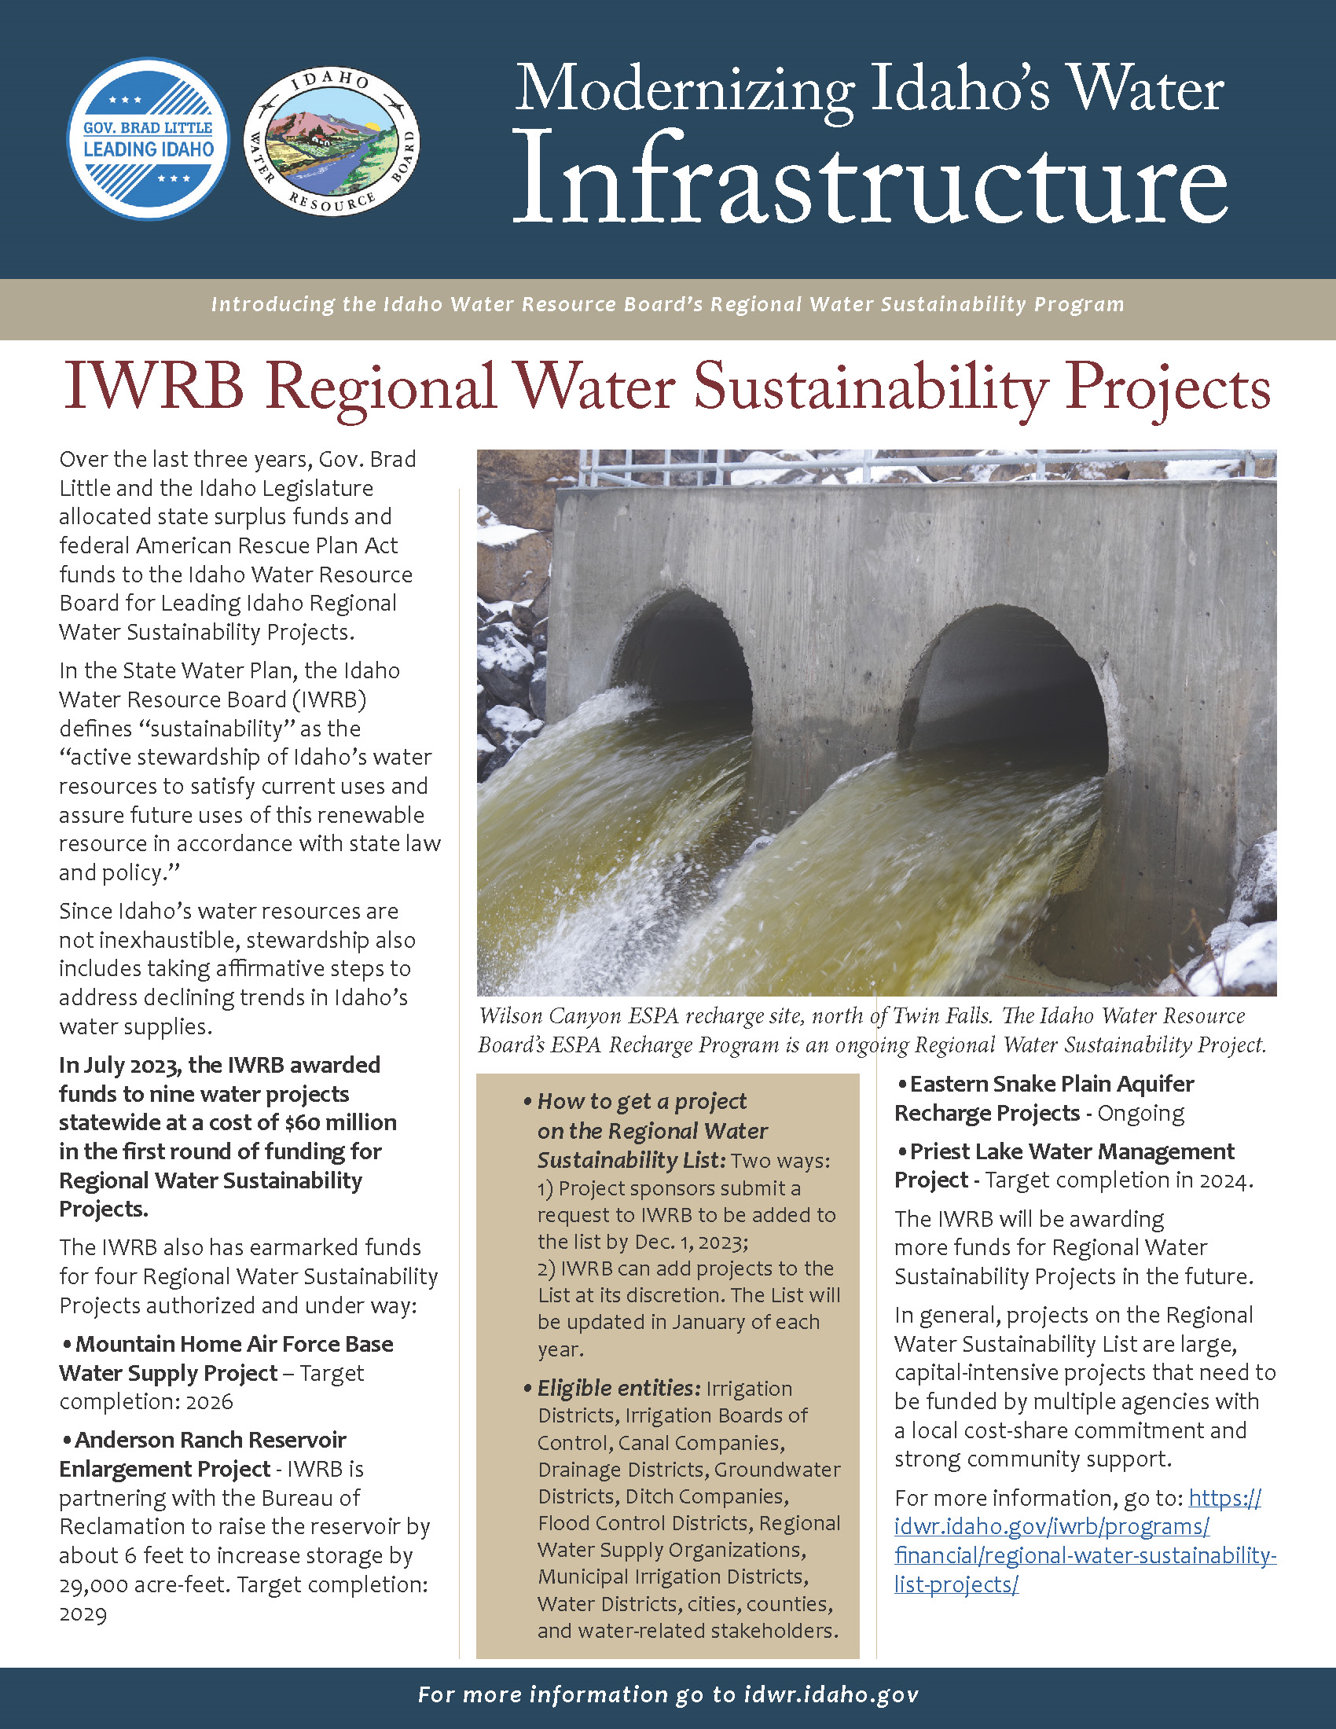
IWRB Programs and Projects
Flood Grants
Loan Program Project or Sustainability Project
Aging Infrastructure Grants
Cloud Seeding or Recharge Project
Other Project
Idaho Water Resource Board Programs, Projects & Initiatives Map

Slide 36
Minimum Stream Flow
Established in 1978 (Idaho Code Title 42, Chapter 15)
Idaho Code Section 42-1502 Definition: Flow or volume required to protect the fish and wildlife habitat, aquatic life, recreation, aesthetic beauty, navigation, transportation, or water quality of a stream.
Held by the Idaho Water Resource Board in the public interest.
Idaho Code Section 42-1503 Approval Criteria:
  Cannot impact any senior water right
  Must be necessary to protect instream values
  Must be minimum, not optimum
  Must be capable of being maintained
  Must be in the public, not private interest

Slide 37
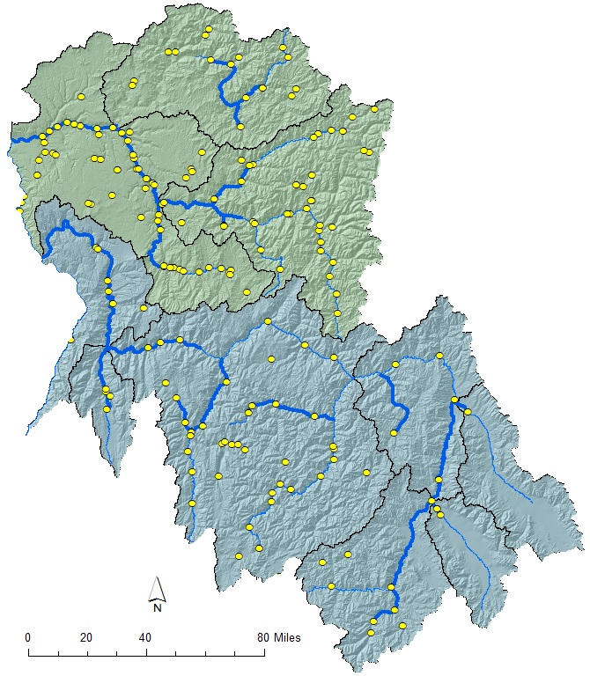
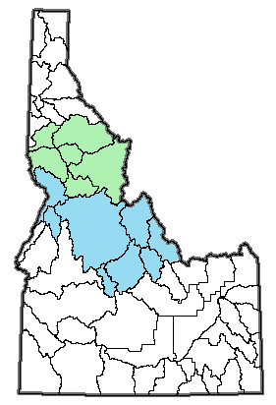
Salmon & Clearwater R. Basins
Clearwater River Basin
MSF Point
MSF Reach
Major River
IDWR Basin
Salmon River Basin

Slide 38
Lemhi River MSF
MSF 74-14993
  Rate: 35 cfs
  Priority date : 4/12/2001
  7.5 miles reach - L6 diversion to confluence Lemhi and Salmon Rivers
Goals
  Permanently protect 35cfs in the Lower Lemhi River
  4 Lemhi River tributaries reconnected by 2010
  10 Lemhi River tributaries reconnected by 2024
  Promote flow and volume restoration, habitat and biological improvements and water user relationships
Special legislation passed to authorize Lemhi River MSF (HB 358, 2001)
  42-1506 authorized IWRB appropriate a MSF water right on the Lemhi River without available flow
  42-1765A authorized creation of a rental pool committee to operate a water supply bank in the Lemhi River basin
Notes:
Water Right 74-14993
Conditions:
Fifteen (15) cfs of the thirty-five (35) cfs is subordinated to all diversions, including high water or flood water authorized under the Lemhi River basin decree.
The purpose of this minimum stream flow is to provide for the passage of anadromous fish in the authorized river reach.

Slide 39
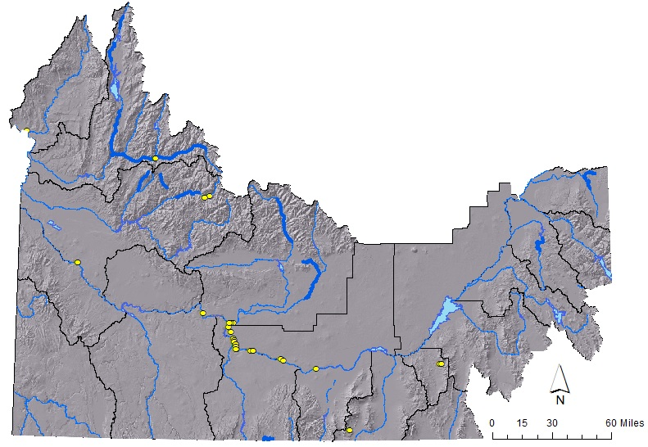
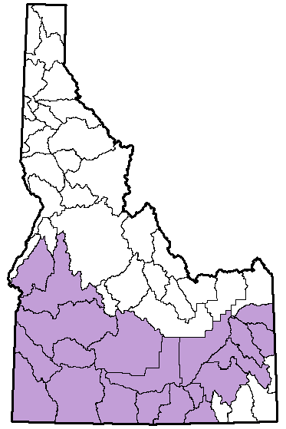
Snake River MSFs
MSF Point
MSF Reach
Major River
IDWR Basin
Weiser Gage (3,300)
Milner Dam (0)
Murphy Gage (3,900/5,600)
Notes:
57% of the surface area of Idaho is within the Snake River Basin (State Water Plan, pg. 43).
Water supply for 76% of Idaho’s population (State Water Plan, pg 43.
Three critical locations on the Snake River: Weiser, Murhpy, Milner

Slide 40
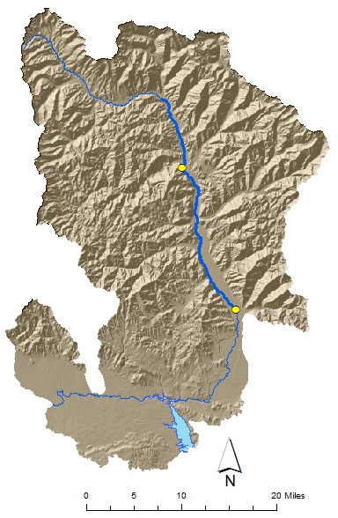
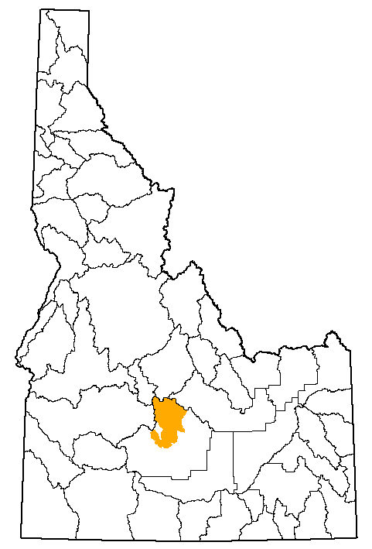
Big Wood River
MSF Water Rights
  37-7919: 70 cfs (6/19/1981)
  37-8258: 150-200 cfs (1/16/1986)
  37-8307: 119 cfs (10/26/1987)
Later two rights subordinate to domestic and muncipal gw rights as allowed in ground water management plan
Challenges: New water right applications may impact MSF, difficult to administer water rights to protect MSF
MSF Point
MSF Reach
Major River
IDWR Basin
Sun Valley &
Hailey
Magic Reservoir (irrigation)
Notes:
Water right 37-7919:
70 cfs, Priority Date: 6/19/1981
Requested by IDFG to protect trout fisheries from confluence with Warm Springs Creek to Bellevue Canal
Rate justified based upon 1970s methodology
Water right 37-8258:
150-200 cfs, Priority Date: 6/19/1981
Requested by Blaine County P&Z to maintain fish and wildlife habitat, water quality, aesthetics, and recreation
Boundary with Sawtooth National Rec Area to confluence with Warm Springs Creek
Evidenced by records showing flow of 200cfs is maintained 50.7% of time. The purpose is not to maintain flow 100%, but to prevent dewatering by later rights during periods of low flow. 200 cfs between April and August based on conclusion that flow is capable of being maintained. 150 cfs between Sept and March based on max flow at upper gage near Ketchum plus 25% to account for inflows from N. Fk Big Wood.
Water right 37-8307:
119 cfs (on top of 70cfs)
Priority Date: 10/26/1987
Requested by Blaine County P&Z to maintain fish and wildlife habitat, water quality, aesthetics, and recreation
Boundary with Sawtooth National Rec Area to confluence with Warm Springs Creek
Additional rate approved through hearing based on flow records that showed “flows in Big Wood River with suffcient frequency during all months of the year.”
Challenges: Basin moratorium, new applications propose moving ground water or surface water from minimum flow reach to points upstream, difficult to administer (particularly if new right is for groundwater due to lag time)
Should IWRB actively call for the administration of its water right? Should the IWRB protest applications and transfers? Set’s up conflict between different interests/cultures resort/recreational vs. municipal vs. agricultural

Slide 41
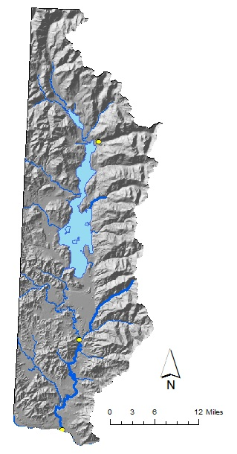
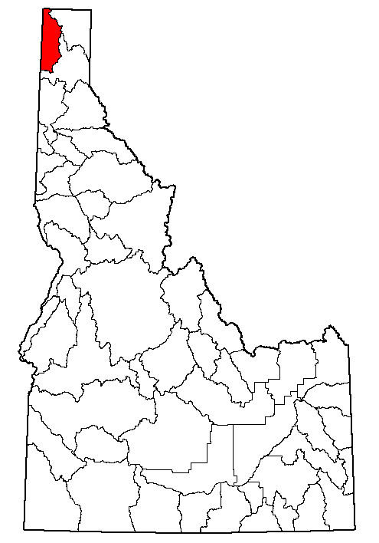
Priest River
MSF 97-7380
Priority Date: 10/22/1997
Flows:
  1,500 cfs (4/01 – 6/30)
  951cfs (7/1- 7/31)
  300 cfs (8/01 – 10/31)
  700 cfs (11/01 – 3/31)
Subordinate to statutory Priest Lake level operation requirements (Idaho Code § 70-507)
Challenges: New water right applications may impact MSF, lake level requirements limit ability to fill MSF downstream
MSF Point
MSF Reach
Major River
IDWR Basin
Priest Lake MLL = 3’
Priest River
MSF = 300-951 cfs
Notes:
70-507. Director of the department of water administration to have supervision and control. The Priest Lake outlet control structure shall, when constructed, be under the supervision and control of the director of the department of water administration, who may enter into contracts for a period of one (1) year or more with persons or corporations, by him deemed qualified, to operate and maintain, at their sole expense, said outlet control structure or any other control structure erected as a replacement thereof: provided, however, that under no circumstances shall the water surface level of Priest Lake be maintained or regulated by said director of the department of water administration above 3.0 feet on the present United States Geological Survey Priest Lake outlet gage with gage datum of 2434.64 feet above mean sea level, datum of 1929, supplementary adjustment of 1947, or released below 0.1 feet on said gage; provided further, that the water surface level of Priest Lake shall be maintained at 3.0 feet on the United States Geological Survey Priest Lake outlet gage, from and after the time each year following the run-off of accumulated winter snows, when the surface level of the waters of Priest Lake has receded to such elevation, until the time after the close of the main recreational season, as determined by said director of the department of water administration, that said lake waters may be released and the surface level permitted to recede below said elevation 3.0.

Slide 42
E. Water Transaction Program

Slide 43
Upper Salmon River Basin
Issue:
Local economies depend on the diversion of tributary water, but diversions can dewater streams and lead to migration barriers and habitat degradation for Endangered Species Act listed fish.
Solution:
Implement a voluntary program that compensates water right owners for changes in irrigation practices that protect the local economy while providing the flows required for recovery of ESA-listed species in accordance with Idaho water law.

Slide 44
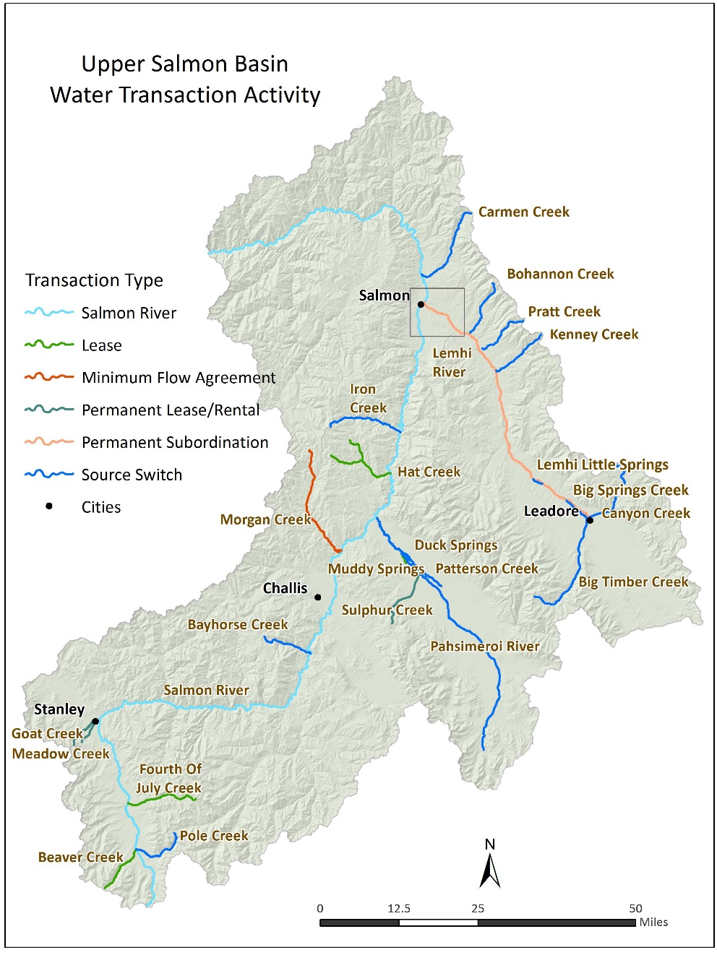
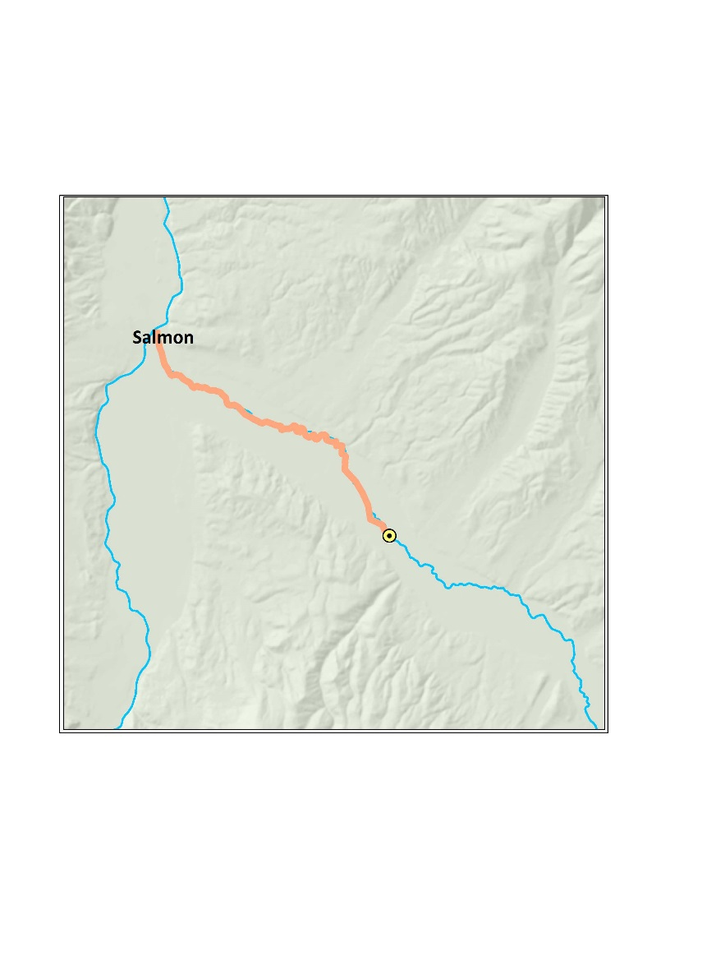
Progress to Date
L-6 Diversion
Lower Lemhi Agreements
Permanent Subordination
Annual Subordination
Notes:
Most source switches in Lemhi basin; connecting high quality fish habitat to the mainstem rivers
Leases are primarily opportunistic – landowners do not wish to irrigate (primarily because they are recreational properties and not working ranches) but want to protect their water rights from forfeiture; some are paid leases, some are donated leases
Permanent subordination agreements and annual agreements on Lemhi – trying to maintain those target flows for fish passage
Permanent lease/rentals aka acquisitions – these are rare (3 total); in the case of Goat and Meadow Creek and the Knapp Creek acquisition – the entity that purchased the properties understood that the USFS would take ownership of the water rights (as they do in most Western states), but the USFS has determined they will no longer purchase water rights in Idaho, and therefore the Board and the water transaction program were asked to take ownership of the water before the land could be conveyed to the USFS using Land and Water Conservation Funds
Created by Congress in 1964, the Land and Water Conservation Fund (LWCF) was a bipartisan commitment to safeguard natural areas, water resources and our cultural heritage, and to provide recreation opportunities to all Americans. It uses revenues from the depletion of one natural resource - offshore oil and gas - to support the conservation of another precious resource - our land and water. Every year, $900 million in royalties paid by energy companies drilling for oil and gas on the Outer Continental Shelf (OCS) are put into this fund. The money is intended to protect national parks, areas around rivers and lakes, national forests, and national wildlife refuges from development, and to provide matching grants for state and local parks and recreation projects

